Slide 1
Introduction to C Programming

Slide 2
Control/ Control flow statements
In C, the semicolon is a statement terminator.
Braces { and } are used to group declarations and statements together into a compound statement, or block, so that they are syntactically equivalent to a single statement.
The braces that surround the statements of a ‘main’ function are one obvious example; braces around multiple statements after an if, else, while, or for are another.
There is no semicolon after the right brace that ends a block.
C programming language assumes any non-zero and non-null values as true, and if it is either zero or null, then it is assumed as false value.

Slide 3
Control Instruction
To alter our actions by circumstances.
If the weather is fine, then I will go for a stroll
If the highway is busy I would take a diversion
Notice that all these decisions depend on some condition being met
C language too must be able to perform different sets of actions depending on the circumstances
C has three major decision making or conditional statements.
if-else statement
switch statement
conditional operator(?:) statement

Slide 4
The if Statement
The if - else statement is used to carry out a logical test and then take one of two possible actions, depending on the outcome of the test (i.e., whether the outcome is true or false).
The else portion of the if - else statement is optional. Thus, in its simplest general form, the statement can be written as
if (expression)
statement
The expression must be placed in parentheses, as shown.
In this form, the statement will be executed only if the expression has a nonzero value (i.e., if expression is true).
If the expression has a value of zero (i.e., if expression is false), then the statement will be ignored.
The statement can be either simple or compound.

Slide 5
The expression in if
The expression can be any valid expression:
if ( (3 + 3) % 5 )
printf ( "This works" ) ;
if ( a = 10 )
printf ( "Even this works" ) ;
if ( -5 )
printf ( "Surprisingly even this works" ) ;
C a non-zero value is considered to be true, whereas a 0 is considered to be false.

Slide 6
The if Statement
Several representative of if statements are shown below.
if ( x < 0) printf ( "%f”, x );
if (due > 0)
credit = 0;
if (x <= 3.0) {
y = 3 * pow(x, 2 ) ;
printf( "%f\n", y) ;
}

Slide 7
The if Statement
if ((balance < 1000) || (status == ‘R’ ))
printf( "%f”, balance);
if (( a >= 0) && (b <= 5 ) ) {
xmid = (a + b) / 2;
ymid = sqrt(xmid);
}

Slide 8
The if else Statement
The general form of an if statement which includes the else clause is
if (expression)
statement 1
else
statement 2
If the expression has a nonzero value (i.e., if expression is true), then statement 1 will be executed.
Otherwise (i.e., if expression is false), statement 2 will be executed.

Slide 9
The if-else Statement contd…
The group of statements after the if upto and not including the else is called an ‘if block’. Similarly, the statements after the else form the ‘else block’.
Notice that the else is written exactly below the if.
Had there been only one statement to be executed in the if block and only one statement in the else block we could have dropped the pair of braces.
As with the if statement, the default scope of else is also the statement immediately after the else.

Slide 10
The if else Statement
Here are several examples illustrating the use of if-else statement.
if(status == 'S’)
tax = 0.20 * pay;
else
tax = 0.14 * pay;
if (due > 0) {
printf(“account number %d is overdue”, accountno);
credit= 0;
}
else
credit = 1000.0;

Slide 11
The if else Statement
if (x <= 3)
y = 3 * pow(x, 2);
else
y = 2 * pow((x – 3) , 2 );
printf( "%f \n”, balance);

Slide 12
The if else Statement
if (circle) {
scanf("%f", &radius);
area = 3.14159 * radius * radius;
printf( “Area of circle= %f”,area);
}
else {
scanf ("%f %f” , &length, &width) ;
area = length * width;
printf( " Area of rectangle = %f ”,area);
}

Slide 13
The if Statement- Example
#include <stdio.h>
int main () {
/* variable definition */
int a = 10;
/* check the boolean condition using if statement */
if( a < 20 ) {
/* if condition is true then print the following */
printf("a is less than 20\n" );
}
printf("value of a is : %d\n", a);
return 0;
}

Slide 14
The if-else Statement Example
#include <stdio.h>
int main () {
// variable definition
int a = 100;
// check the boolean condition
if( a < 20 ) {
// if condition is true then print the following
printf("a is less than 20\n" );
}
else {
// if condition is false then print the following
printf("a is not less than 20\n" );
}
printf("value of a is : %d\n", a);
return 0;
}

Slide 15
The if-else Statement Example
Output:
a is not less than 20;
value of a is : 100

Slide 16
The if else Statement (dangling else problem)
Because the else part of an if-else is optional, there is an ambiguity when an else is omitted from a nested if sequence.
This is resolved by associating the else with the closest previous else-less if.
For example, in
if (n > 0)
if (a > b)
z = a;
else
z = b;
the else goes with the inner if, as we have shown by indentation.
If that isn't what you want, braces must be used to force the proper association:

Slide 17
The nested if Statement
It is possible to nest (i.e., embed) if statements, one within another.
There are several different forms that nested if statements can take.
The syntax for a nested if statement is as follows −
if( expression 1) {
/* Executes when the expression 1 is true */
if(expression 2) {
/* Executes when the expression 2 is true */
}
}
else {
//else statement block
}

Slide 18
The nested if Statement
#include<stdio.h>
void main() {
int x=20,y=30;
if(x==20) {
if(y==30) {
printf("value of x is 20, and value of y is 30.");
}
printf(“y is not equal to 30”);
}
printf(“this will always print”);
}

Slide 19
The if Statement – Example
/* Demonstration of if statement */
#include<stdio.h>
void main( ) {
int num ;
printf ( "Enter a number less than 10 " ) ;
scanf ( "%d", &num ) ;
if ( num <= 10 )
printf ( "What an obedient servant you are !" ) ;
}

Slide 20
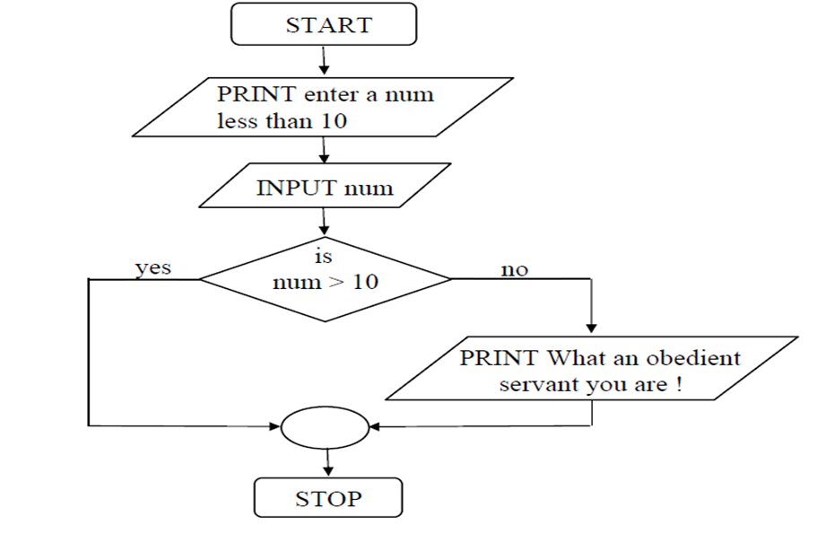

Slide 21
The if Statement – Example
While purchasing certain items, a discount of 10% is offered if the quantity purchased is more than 1000. If quantity and price per item are input through the keyboard, write a program to calculate the total expenses.
void main( ) {
int qty, dis = 0 ;
float rate, tot ;
printf ( "Enter quantity and rate " ) ;
scanf ( "%d %f", &qty, &rate) ;
if ( qty > 1000 )
dis = 10 ;
tot = ( qty * rate ) - ( qty * rate * dis / 100 ) ;
printf ( "Total expenses = Rs. %f", tot ) ;
}

Slide 22
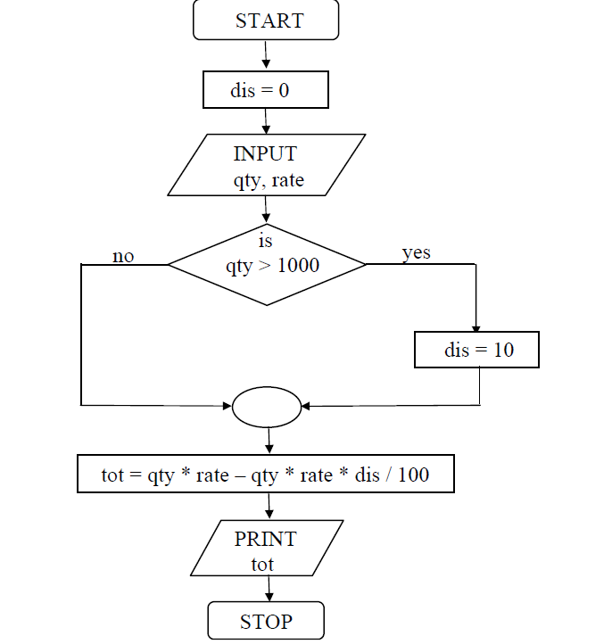

Slide 23
The if Statement – Example
The current year and the year in which the employee joined the organization are entered through the keyboard. If the number of years for which the employee has served the organization is greater than 3 then a bonus of Rs. 2500/- is given to the employee. If the years of service are not greater than 3, then the program should do nothing.

Slide 24
#include<stdio.h>
void main( )
{
int bonus, cy, yoj, yr_of_ser ;
printf ( "Enter current year and year of joining " ) ;
scanf ( "%d %d", &cy, &yoj ) ;
yr_of_ser = cy - yoj ;
if ( yr_of_ser > 3 )
{
bonus = 2500 ;
printf ( "Bonus = Rs. %d", bonus ) ;
}
}

Slide 25
The if-else Statement Example
Example. In a company an employee is paid as under: If his basic salary is less than Rs. 1500, then HRA = 10% of basic salary and DA = 90% of basic salary. If his salary is either equal to or above Rs. 1500, then HRA = Rs. 500 and DA = 98% of basic salary. If the employee's salary is input through the keyboard write a program to find his gross salary.

Slide 26
#include<stdio.h>
void main( )
{
float bs, gs, da, hra ;
printf ( "Enter basic salary " ) ;
scanf ( "%f", &bs ) ;
if ( bs < 1500 )
{
hra = bs * 10 / 100 ;
da = bs * 90 / 100 ;
}
else
{
hra = 500 ;
da = bs * 98 / 100 ;
}
gs = bs + hra + da ;
printf ( "gross salary = Rs. %f", gs ) ;
}

Slide 27
Nested if...else statement (if...else if....else Statement)
The nested if...else statement allows you to check for multiple test expressions and execute different codes for more than two conditions.
When a logical expression is encountered whose value is nonzero (true), the corresponding statement will be executed and the remainder of the nested if - else statements will be bypassed.
Thus, control will be transferred out of the entire nest once a true condition is encountered.
The final else clause will apply if none of the expressions is true. It can be used to provide a default condition or an error message.

Slide 28
The if…else if…else Statement
An if statement can be followed by an optional else if...else statement, which is very useful to test various conditions .
else if statements in C is like another if condition, it’s used in program when if statement having multiple decisions.
When using if...else if…else statements, there are few points to keep in mind −
An if can have zero or one else's and it must come after any else if's.
An if can have zero to many else if's and they must come before the else.
Once an else if succeeds, none of the remaining else if's or else's will be tested.

Slide 29
Nested if...else statement (if...else if....else Statement)
if (testExpression1) {
// statements to be executed if testExpression1 is true
}
else if(testExpression2) {
// statements to be executed if testExpression1 is false and testExpression2 is true
}
else if (testExpression 3) {
// statements to be executed if testExpression1 and testExpression2 is false and testExpression3 is true
}
……..
else {
// statements to be executed if all test expressions are false
}

Slide 30
Nested if...else statement (if...else if....else Statement) Example
#include <stdio.h>
int main () {
int a = 100;
if( a == 10 ) {
printf("Value of a is 10\n" );
}
else if( a == 20 ) {
printf("Value of a is 20\n" );
}
else if( a == 30 ) {
printf("Value of a is 30\n" );
}
else {
printf("None of the values is matching\n" );
}
printf("Exact value of a is: %d\n", a );
return 0;
}
Output:
None of the values is matching
Exact value of a is: 100

Slide 31
Nested if...else statement (if...else if....else Statement) Example
// Program to relate two integers using =, > or <
#include <stdio.h>
int main() {
int number1, number2;
printf("Enter two integers: ");
scanf("%d%d",&number1, &number2);
//checks if two integers are equal.
if(number1 == number2) {
printf("Result:%d= %d",number1,number2);
}
//checks if number1 is greater than number2.
else if (number1 > number2) {
printf("Result:%d > %d", number1, number2);
}
// if both test expression is false
else {
printf("Result: %d < %d",number1, number2);
}
return 0;
}

Slide 32
Nested if-else Example
#include<stdio.h>.
void main( ) {
int i ;
printf ( "Enter either 1 or 2 " ) ;
scanf ( "%d", &i ) ;
if ( i == 1 )
printf ( "You would go to heaven !" ) ;
else {
if ( i == 2 )
printf ( "Hell was created with you in mind" ) ;
else
printf ( "How about mother earth !" ) ;
}
}

Slide 33
Forms of if
The if statement can take any of the following forms:
(a) if ( condition )
do this ;
(b) if ( condition ) {
do this ;
and this ;
}
(c) if ( condition )
do this ;
else
do this ;

Slide 34
Forms of if
(d) if ( condition ) {
do this ;
and this ;
}
else {
do this ;
and this ;
}

Slide 35
Forms of if
(e) if ( condition )
do this ;
else {
if ( condition )
do this ;
else {
do this ;
and this ;
}
}

Slide 36
(f) if ( condition ) {
if ( condition )
do this ;
else {
do this ;
and this ;
}
}
else
do this ;

Slide 37
Nested if-else Example
The marks obtained by a student in 5 different subjects are input through the keyboard. The student gets a division as per the following rules:
Percentage above or equal to 60 - First division
Percentage between 50 and 59 - Second division
Percentage between 40 and 49 - Third division
Percentage less than 40 - Fail
Write a program to calculate the division obtained by the student.

Slide 38
#include<stdio.h>
void main( )
{
int m1, m2, m3, m4, m5, per ;
printf ( "Enter marks in five subjects " ) ;
scanf ( "%d %d %d %d %d", &m1, &m2, &m3, &m4, &m5 ) ;
per = ( m1 + m2 + m3 + m4 + m5 ) / 5 ;
if ( per >= 60 )
printf ( "First division ") ;
else
{
if ( per >= 50 )
printf ( "Second division" ) ;
else
{
if ( per >= 40 )
printf ( "Third division" ) ;
else
printf ( "Fail" ) ;
}
}
}

Slide 39
#include<stdio.h> // PRGRAM WITH nested if else.
void main( )
{
int m1, m2, m3, m4, m5, per ;
printf ( "Enter marks in five subjects " ) ;
scanf ( "%d %d %d %d %d", &m1, &m2, &m3, &m4, &m5 ) ;
per = ( m1 + m2 + m3 + m4 + m5 ) / 5 ;
if ( per >= 60 )
printf ( "First division" ) ;
else if ( per >= 50 )
printf ( "Second division" ) ;
else if ( per >= 40 )
printf ( "Third division" ) ;
else
printf ( "Fail" ) ;
}

